Slide 1
Fast Anomaly Detection for Streaming Data
Presented by: Feras Shamasna
(NIQWQX)
Notes:
2011 , SIM University, Singapore
Monash University, Australia

Slide 2
Main Ideas
The paper introduces Streaming Half-Space-Trees (HS-Trees), a fast one-class anomaly detector for evolving data streams with continuous attributes.
The proposed approach based on ensemble of random HS-Trees.
The tree structure is constructed without any data.
The Streaming HS-Trees has constant amortized time complexity and constant memory requirement.
Notes:
It requires only normal data for training and works well when anomalous data are rare.
This makes the method highly efficient because it requires no model restructuring when adapting to evolving data streams.
Half space Tree: An HS-Tree of depth h is a full binary tree consisting of (2^h+1) − 1 nodes, in which all leaves are at the same depth, h.

Slide 3
Challenges in detecting anomalies is streaming data
The stream is infinite, so any off-line learning algorithms that attempt to store the entire stream for analysis will run out of memory space.
Secondly, the stream contains mostly normal instances because anomalous data are rare and may not be available for training.
Thirdly, streaming data often evolve over time.
Notes:
. In this case, any multi-class classifiers that require fully labeled data will not be suitable.
Thus, the model must adapt to different parts of the stream in order to maintain high detection accuracy.

Slide 4
Features of the proposed approach
Addresses the previously-mentioned challenges.
It processes data in one pass and only requires constant amount of memory to process potentially endless streaming data or massive datasets.
Streaming HS-Trees is a one-class anomaly detector which is useful when a stream contains a significant amount of normal data.
it performs fast model updates in order to maintain high detection accuracy when dealing with time-varying data distribution.
Notes:
Its model update is simple and fast because it requires no modifications of the tree structure when processing streaming data.

Slide 5
Anomaly scoring
Streaming HS-Trees employs mass as a measure to rank anomalies. The mass profile can be constructed with small samples, allowing the anomaly detector to learn quickly and adapt to changes in data streams in a timely manner.

Slide 6
HS trees vs. Other decision trees
Streaming HS-Trees does not induce its tree structure from actual training examples. Instead, the tree structure is constructed using the data space dimensions alone. The trees can be built quickly because it requires no attribute or split-point evaluations.
What are the advantages of that?
Notes:
The model can be deployed before the streaming data arrive.
A direct consequence of this feature is that Streaming HS-Trees has a constant amortised time complexity and a constant memory requirement.

Slide 7
The proposed method
Reference window & latest window:
To facilitate learning of mass profiles in evolving data streams, the algorithm segments the stream into windows of equal size.
Each window contains a fixed number of data items.

Slide 8
The proposed method (Overview)
During the initial stage of the anomaly detection process, the algorithm learns the mass profile of data in the reference window.
Then, the learned profile is used to infer the anomaly scores of new data subsequently arriving in the latest window.
New data that fall in high-mass subspaces is considered as normal, whereas data in low-mass or empty subspaces is interpreted as anomalous.
As new data arrive at the latest window, the new mass profile is also recorded. When the latest window is full, the newly recorded profile is used to override the old profile in the reference window.
The reference window will always store the latest profile that can be used to score the next batch of newly arriving data.
Once this is done, the latest window erases its stored profile and get ready to capture profile of the next batch of newly arriving data.
This process continues as long as the stream exists.

Slide 9
How we construct the HS tree?
When constructing a tree, the algorithm expands each node by picking a randomly selected dimension, q, in the workspace (to be described later in this section) associated with the node. Using the mid-point of q, the algorithm bisects the workspace into two half-spaces, thus creating the left child and right child of the node. Node expansion continues until the maximum depth (i.e., h or maxDepth) of all nodes is reached.

Slide 10
Each node records the mass profile of data in a workspace that it represents, and has the following elements:
Arrays min and max, which respectively store the minimum and maximum values of each dimension of the workspace represented by the node.
Variables r and l, which record the mass profiles of data stream captured in the reference window and latest window, respectively.
Variable k, which records the depth of the current node.
Two nodes representing the left child and right child of the current node, each associated with a half-space after the split.

Slide 11
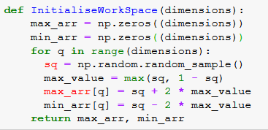
Initialize Workspace:
Before the construction of each tree. Assume that attributes’ ranges are normalized to [0, 1] at the outset. Let sq be a real number randomly and uniformly generated from the interval [0, 1]. A work range, sq ± 2 · max(sq, 1 − sq), is defined for every dimension q in the feature space D.
Notes:
Creating diverse HS-Trees is crucial to the success of our ensemble method. This is achieved by using a procedure:

Slide 12
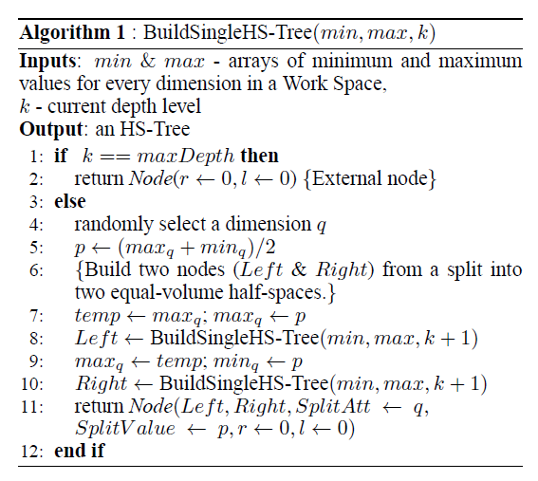
Building a single HSTree
Notes:
Each internal node is formed by randomly selecting a dimension q to form two half-spaces; the split point is the mid-point of the current range of q. The mass variables of each node, r and l, are initialized to zero during the tree construction process.

Slide 13
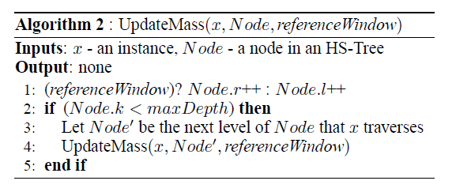
Recording mass profile in HS-Trees
Once HS-Trees are constructed, mass profile of normal data must be recorded in the trees before they can be employed for anomaly detection.
Notes:
These two collections of mass values at each node, r and l, represent the data profiles in the two different windows.
Mass in every partition of an HS-Tree is used to profile the characteristics of data.

Slide 14
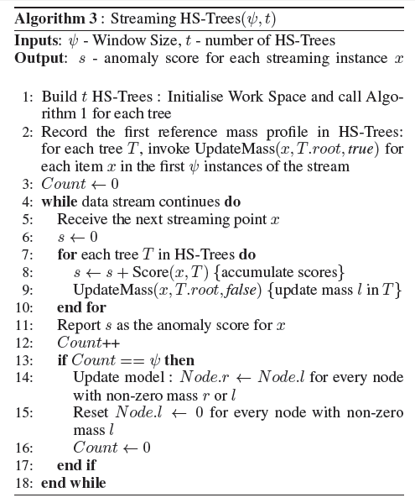
The operational procedure for Streaming HS-Trees:

Slide 15
Experiments & Results
Dataset | Partition Size | Dimensionality
HTTP | 5000 | 3
SMTP | 5000 | 3

Slide 16
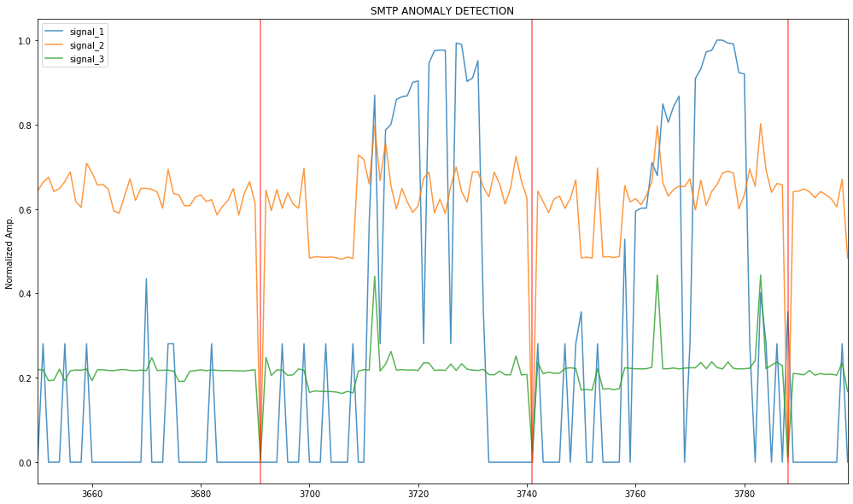
SMTP

Slide 17
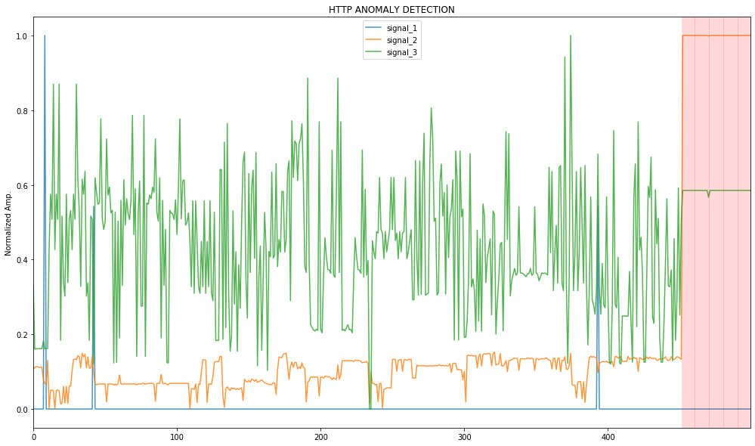
HTTP

Slide 18
Results
 | Precision (Avg) | Recall(Avg) | Number of runs
SMTP | 67% | 67.4% | 10
HTTP | 81% | 81% | 10

Slide 19
Concluding Remarks
The proposed anomaly detection algorithm, Streaming HSTrees, satisfies the key requirements for mining evolving data streams:
It is a one-pass algorithm with O(1) amortized time complexity and O(1) space complexity, which is capable of processing infinite data streams.
It performs anomaly detection and stream adaptation in a seamless manner.

Slide 20
Any Questions?!
Thanks!

